Slide 1
Group: RADAR
Group Members (4):
Hasan Md. Hamidur Rahman
Farhana Tazneen
Debolina Sarkar
Mohammad Imrul Islam

Slide 3
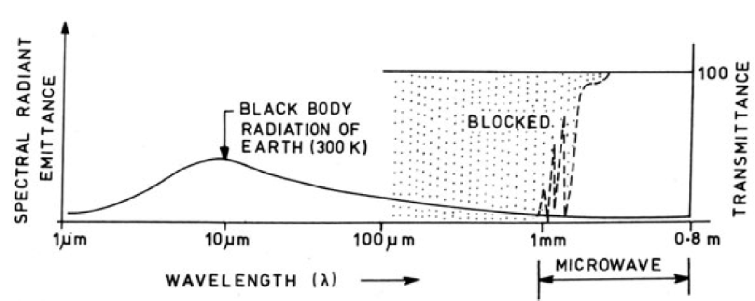
Microwave
The EM spectrum range 1 mm-80 cm is designated as microwave.
For earth observations microwave region can be divided into two main types:
Active microwave and
Passive microwave

Slide 4
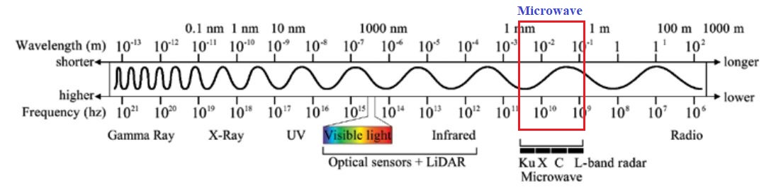
Microwave Spectral Band

Slide 5
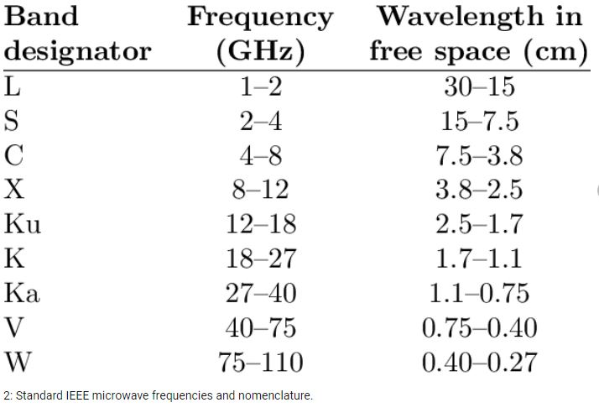
Microwave Band Frequency and Wavelength

Slide 6
Active Microwave (Radar)
Satellite sensors actively emit microwaves toward the Earth's surface. These microwaves reflect off the surface and return to the sensors. This type of remote sensing is called active microwave.
Contd..

Slide 7
Active Microwave
Active microwave sensors provide their own source of microwave radiation to illuminate the target
Active microwave sensors operate in the 1 mm-25 cm wavelengths
Active microwave sensors are divided into two classes:
Imaging and
Non-imaging

Slide 8
Active Microwave Sensors
Among imaging sensors, RADAR, an acronym for RAdio Detection And Ranging
The radar system transmits a microwave signal directing towards the region of interest (ROI) and detects the signal backscattered by the surface
Non-imaging microwave sensors include altimeters and scatterometers.
In most cases these are profiling devices which take measurements in one linear dimension, as opposed to the two-dimensional representation of imaging sensors.

Slide 9
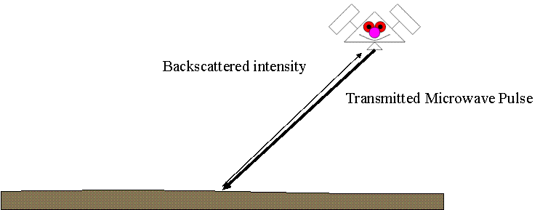
An illustration of the transmitted pulse and its backscatter return in an active system

Slide 10
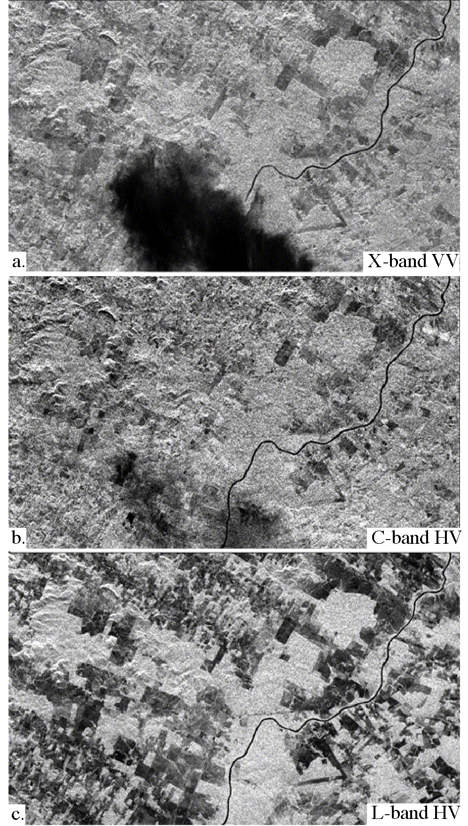
SIR-C/X-SAR Images of a Portion of Rondonia, Brazil, Obtained on April 10, 1994

Slide 11
Passive Microwave
Objects at the Earth's surface emit not only infrared radiation; they also emit microwaves at relatively low energy levels
When a sensor detects microwave radiation naturally emitted by the Earth, that radiation is called passive microwave
Commonly, passive microwave sensors operate in the 1 mm-30 cm wavelengths.

Slide 12
Passive Microwave Sensors
Passive microwave sensing is similar in concept to thermal remote sensing.
All objects emit microwave energy of some magnitude, but the amounts are generally very small.
A passive microwave sensor detects the naturally emitted microwave energy within its field of view.
This emitted energy is related to the temperature and moisture properties of the emitting object or surface.
Passive microwave sensors are typically radiometers or scanners.

Slide 13
The microwave energy recorded by a passive sensor can be
Emitted by the atmosphere
Reflected from the surface
Emitted from the surface or
Transmitted from the subsurface
Because the wavelengths are so long, the energy available is quite small compared to optical wavelengths. Thus, the fields of view must be large to detect enough energy to record a signal.
Most passive microwave sensors are therefore characterized by low spatial resolution.

Slide 14
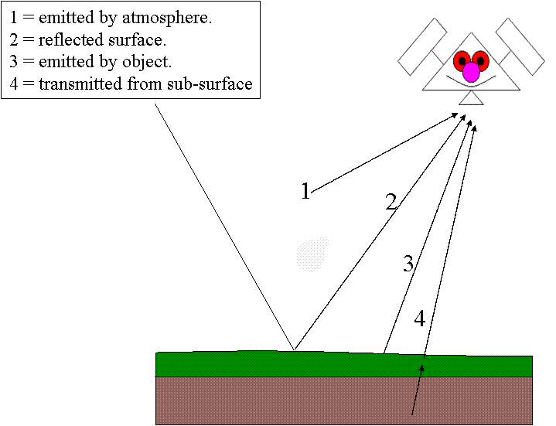
Passive Microwave Sensing

Slide 15
Passive Microwave Sensing
Passive Earth observation has numerous applications, for instance:
- Global surface brightness temperature
- Geological mapping applications
- Soil studies – soil temperature, soil moisture
- Outside surface studies – oceanography, atmospheric sciences

Slide 16
Applications of passive microwave remote sensing
Meteorology, hydrology, and oceanography
Meteorologists can use passive microwaves to measure atmospheric profiles and to determine water and ozone content in the atmosphere.
Hydrologists use passive microwaves to measure soil moisture since microwave emission is influenced by moisture content.
Oceanographic applications include mapping sea ice, currents, and surface winds as well as detection of pollutants, such as oil slicks.

Slide 17
RADAR
The sensor transmits a (radio) signal in the microwave bandwidth and records the part that is backscattered by the target towards the sensor itself.
The power of the backscattered signal allows to discriminate between different targets within the scene, while the time between the sent and the received signal is used to measure the distance of the target.
A system that operates in this way is called RADAR (the name stands for RAdio Detection And Ranging), and may allow to obtain a “microwave image” of the observed scene.

Slide 18
Overview of Radar Use
Radar-based projects started producing results as early as 1967
Widely used in areas of perpetually adverse weather conditions (e.g. cloud coverage)
Difficulties in analyzing the collected imagery as several aspects of expected object behaviors are still unknown
Spaceborne: Seasat (1978)
ESA Envisat: the most advanced to date http://envisat.esa.int/
Radarsat-2 and ALOS (2004)

Slide 19
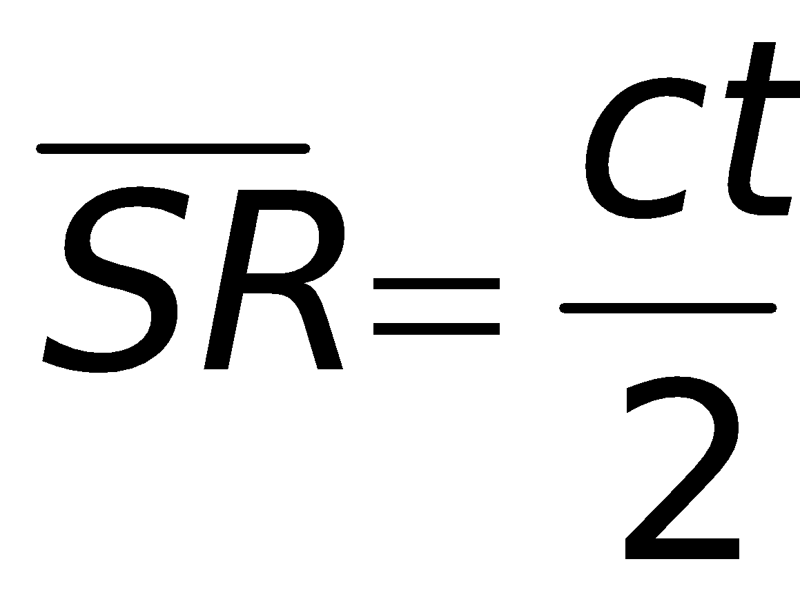
Side-Looking Radar System Operation
Energy propagates in air at the velocity of light c, so the slant range to any object is:
Where:
SR is the direct distance between transmitter and object (slant range)
c is the speed of light (known) (3* 10⁸ m/sec)
t is the time between transmission and echo (return signal) reception
The factor 2 enters into the equation because the time is measured for the pulse to travel the distance both to and from the target

Slide 20
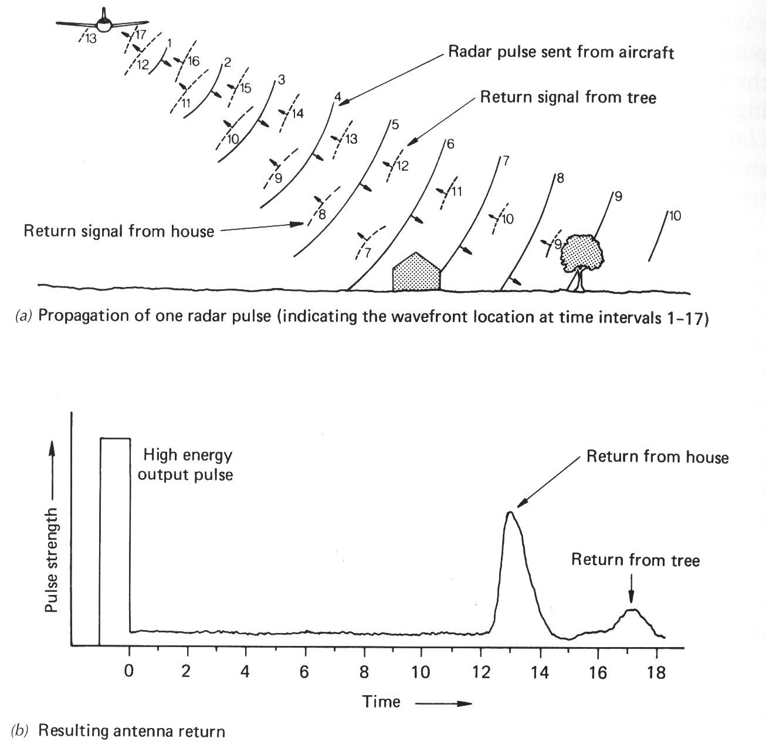

Slide 21
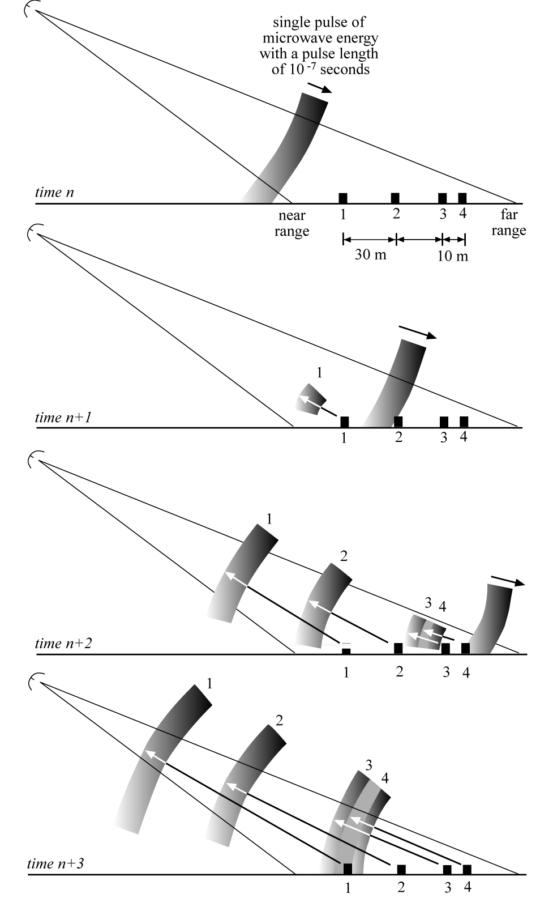
RADAR
logic

Slide 22
SLR Image Formation Steps
As the aircraft moves, the antenna is repositioned along the flight line at the aircraft velocity V_{a}
A synchronized switch switches the antenna from a transmitter to a receiver mode
A portion of each transmitted pulse is received back as echo from the terrain objects that happen along each antenna beamwidth
The signal from one line of data
Echos (returned signal) are received by airborne antenna, processed and recorded

Slide 23
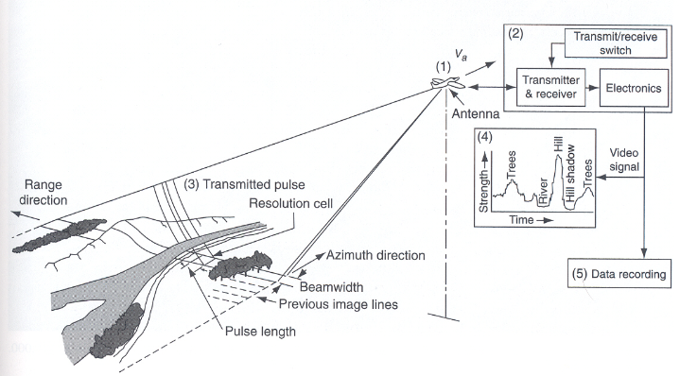
Side-looking radar system operation

Slide 24
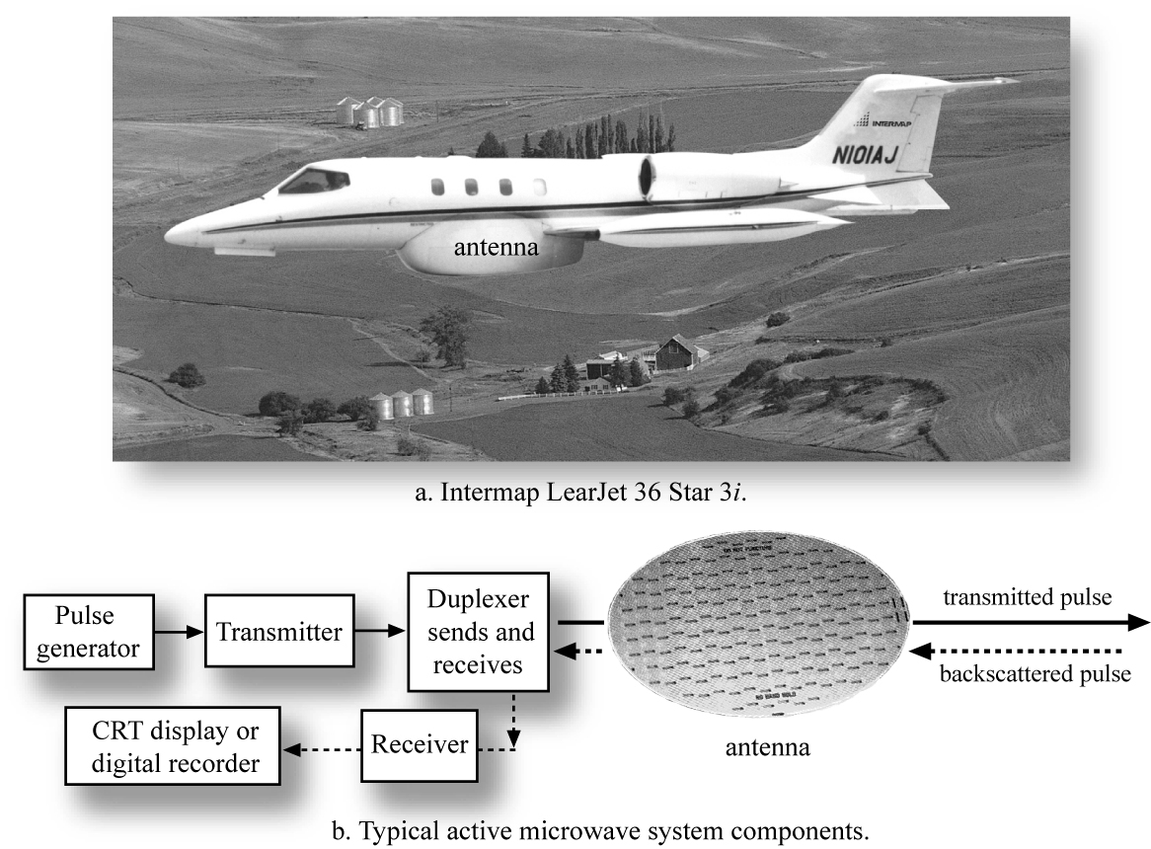
Side-looking Airborne RADAR (SLAR) System

Slide 25
Geometry of Radar Data Collection
Look angle: the angle from nadir to a point of interest on the ground
Depression angle: the complement of look angle
Incident angle: the angle between the incident radar beam at and the ground surface
In the case of airborne imaging over flat terrain, the incident angle and look angle are equal

Slide 26
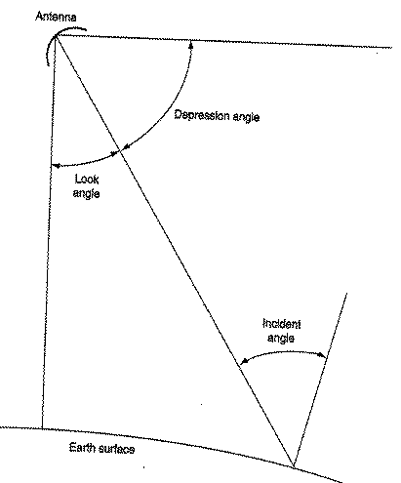
Geometry of Radar

Slide 27
SLR Resolution
Spatial Resolution of SLAR Systems
Pulse length of the radar signal, affects resolution in the range direction (direction of energy propagation): determined by the length of time the antenna emits the pulse
Antenna beamwidth, affects resolution in the azimuth direction (flight direction): determined by the width of the antenna beam

Slide 28
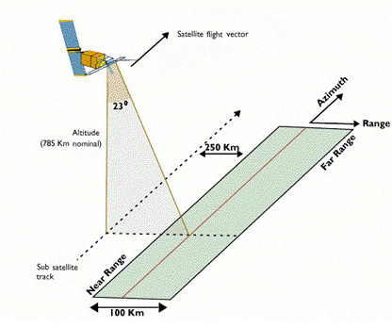
SLAR

Slide 29
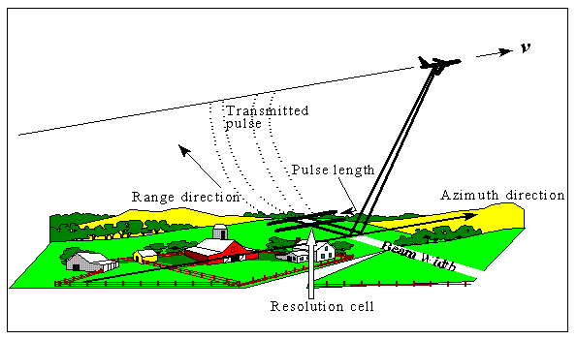
SLR system operation

Slide 30
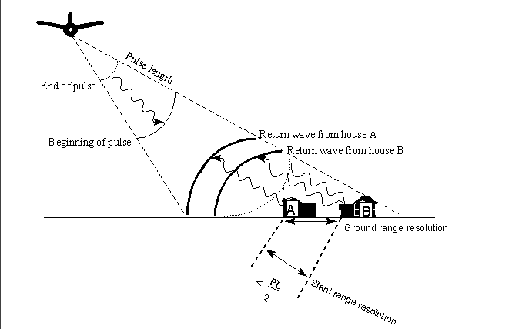
Dependence of range resolution on pulse length
-If the distance between the two houses labeled A and B were greater than {Pulse Length ÷ 2}
they would be distinguished as two separate features.
-If the slant range distance is less than {Pulse Length ÷ 2}, the reflected signals are fuzy
-Slant range resolution does not vary with increasing distance from the aircraft, but ground
range does

Slide 31
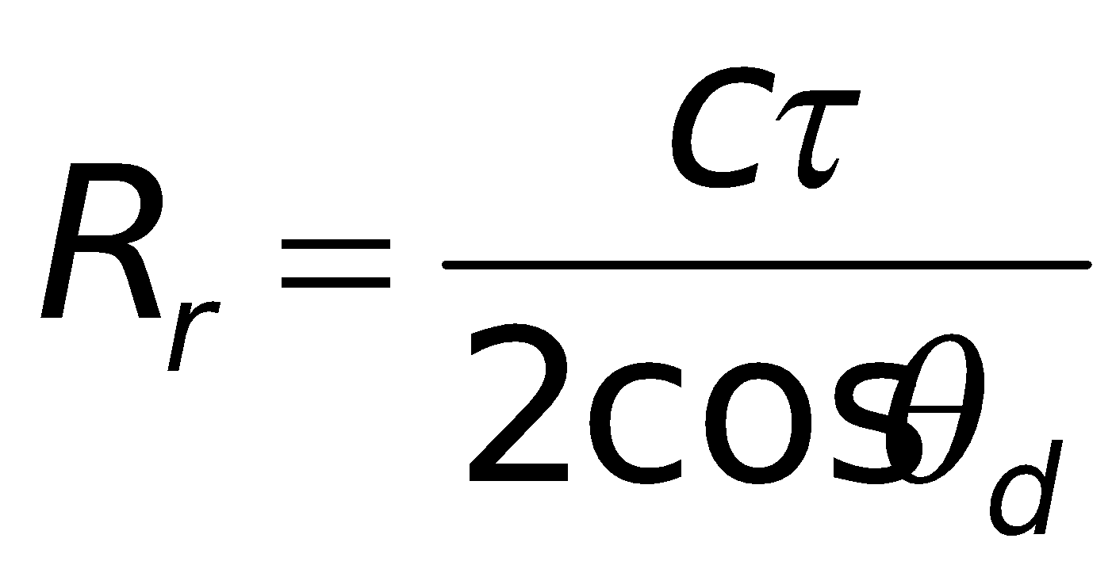
Ground Range Resolution
Ground-range resolution becomes smaller when slant-range increases
R_{r} : ground resolution in the range direction
: pulse duration
θ_{d} : depression angle

Slide 32
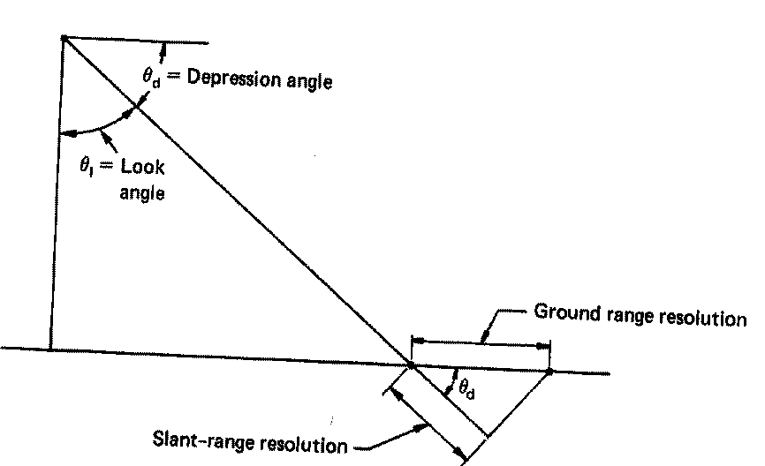
Ground Range Resolution
-As the pulse duration decreases, the ground resolution (horizontal distance)
decreases (meaning that the image can show greater spatial detail)

Slide 33
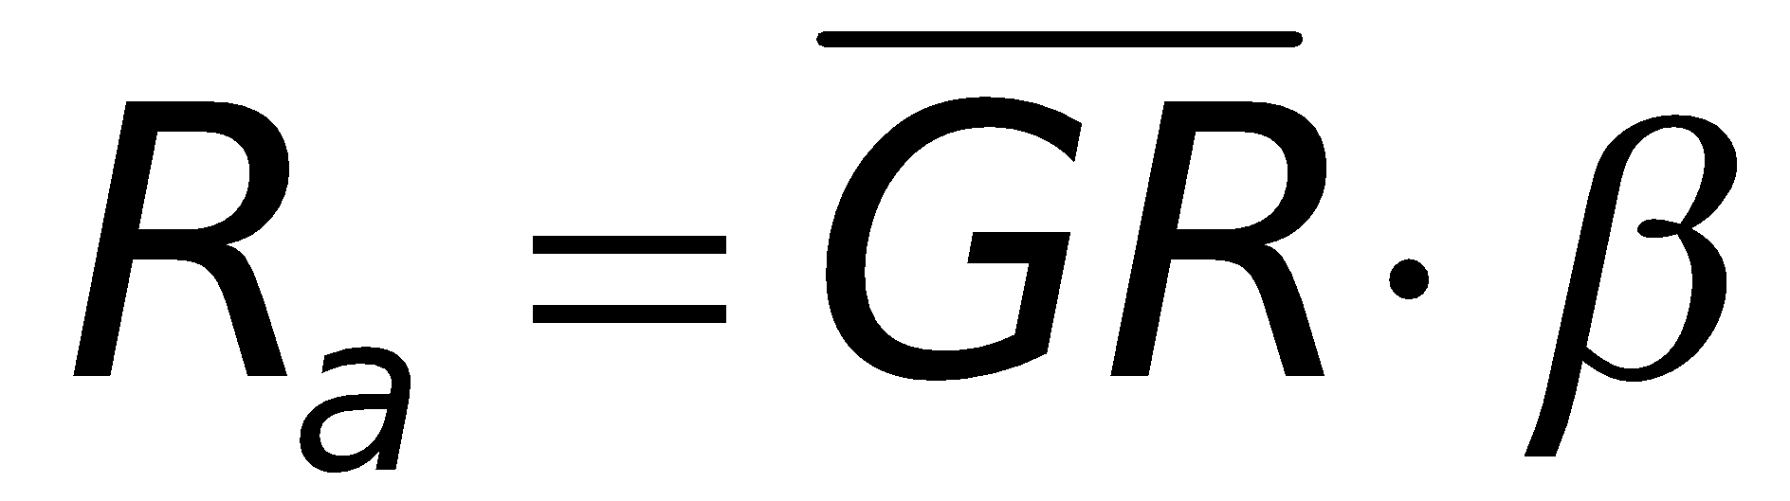
Azimuth Resolution
The azimuth resolution is the ground distance definition in the azimuth direction (the direction of the airplane/satellite is moving).
Azimuth resolution (R_{a} ) : determined by the angular beam width of the antenna β and the ground range GR:
The beam width is directly proportional to wavelength of transmitted pulses and inversely proportional to the length of the antenna
Beam width=Wavelength ÷ Antenna Length

Slide 34
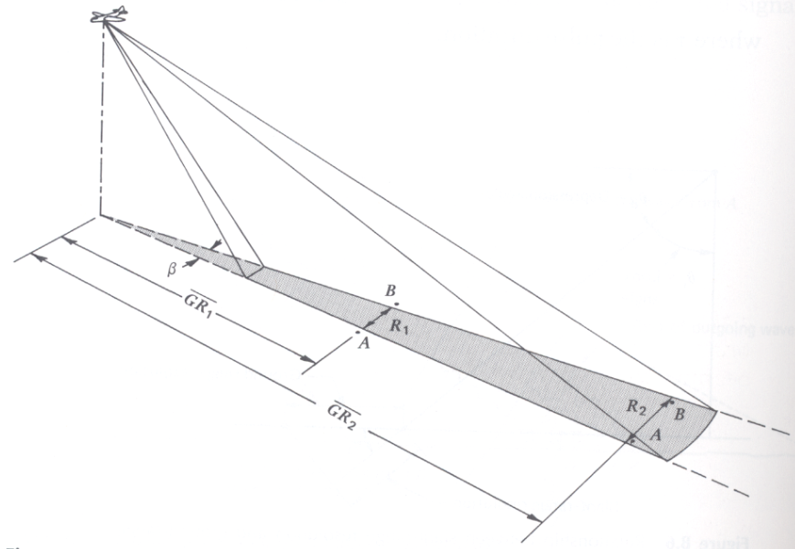
Dependence of azimuth resolution on antenna beam width and ground range

Slide 35
Real Aperture Radars
Radars in which antenna beam width is controlled by its physical length are called real aperture radars
Relatively simple design and data processing
Restricted to short range, low altitude, short wavelengths
Limited area of coverage, and because of shorter wavelengths, more affected by the atmosphere

Slide 36
Synthetic Aperture Radar (SAR)
The most common form of active microwave radar sensors
Antenna of short physical length but able to synthesize the effect of a long antenna (up to 100 m) to attain high spatial resolution images
Along track motion is used to create an array of antennas that can be linked together mathematically
Effective antenna length increases with range
As a result, we have virtually constant azimuth resolution irrespective to range

Slide 37
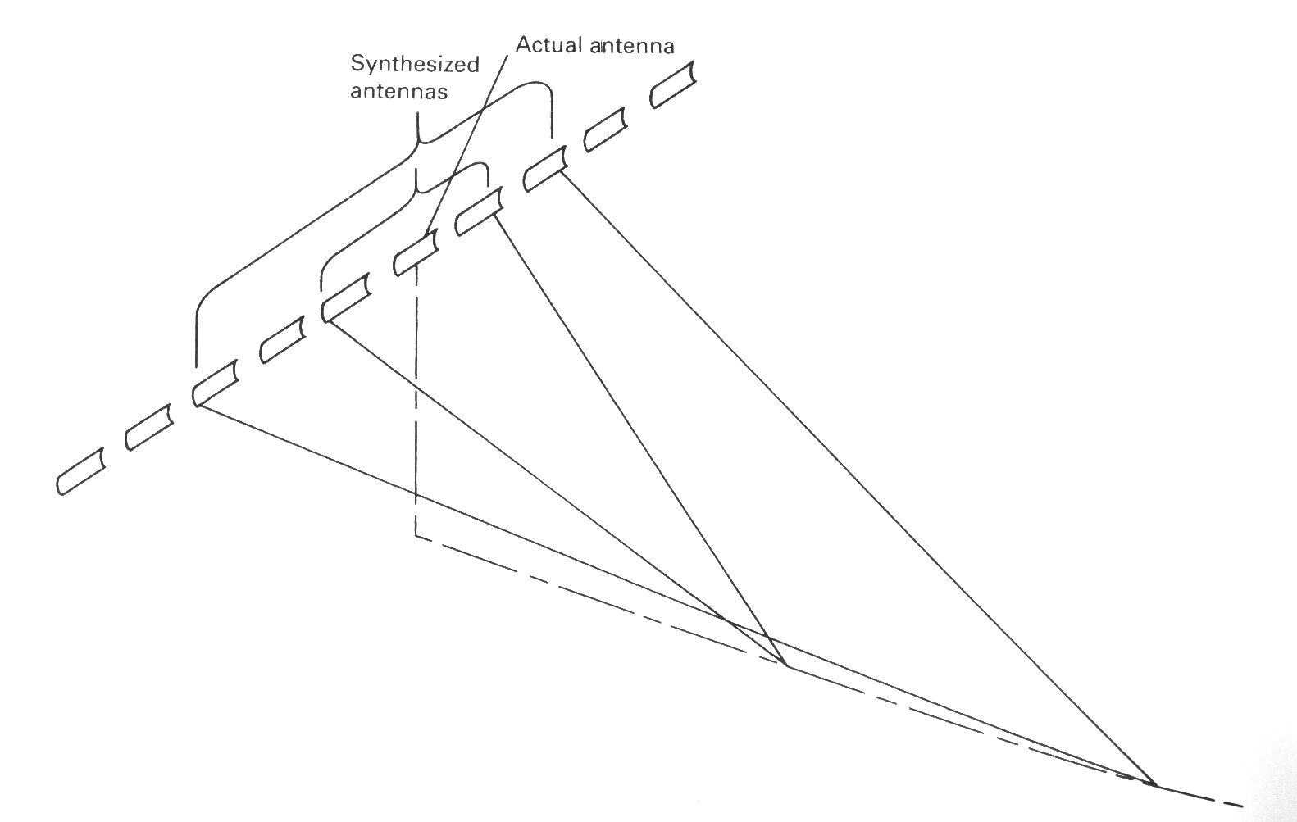
Synthetic Aperture RADAR (SAR)
A longer antenna is “synthesized” electronically by using the same antenna but moving it. Recall that the azimuth resolution gets better with longer antennas in SLAR systems.

Slide 38
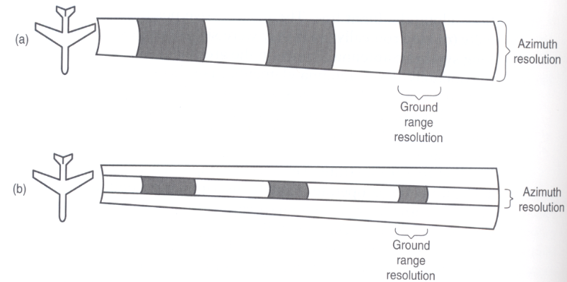
Variation with distance of spatial resolution of real
Aperture (a) versus synthetic aperture (b) SLR system
Real aperture spatial resolution
SAR spatial resolution
-As the distance from the aircraft increases, the azimuth resolution size increases with real aperture systems and remaining constant with
-The ground range resolution size decreases with both systems

Slide 39
Synthetic Aperture Radar (SAR)
Unfocused and focused systems
In focused systems resolution is 1/2 the actual antenna length, which means the shorter the antenna the better the resolution, independently of range or wavelength
In contrast, in unfocused systems, the theoretical resolution is a function of wavelength and range, but not antenna length

Slide 40
Geometric distortions in RADAR
Foreshortening: higher objects are closer to the sensor (Higher is smaller than expected), so will appear to have a shorter ground range, and therefore appear closer to the sensor than it really is
Layover: an extreme case of foreshortening, when the top of an object is detected before the bottom
Shadowing: Objects may block radar from hitting objects behind them

Slide 41
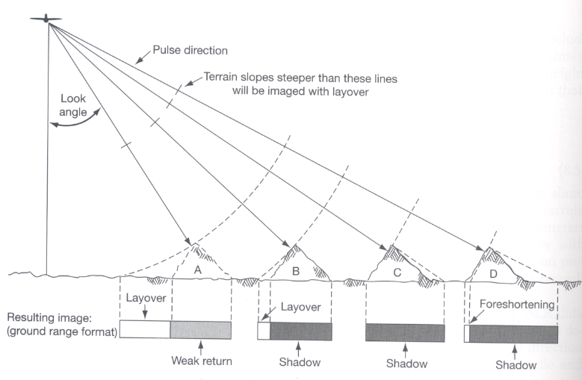
Geometric distortions in RADAR

Slide 42
Image Interpretation
Factors that affect the intensity of radar returns: geometric and electrical characteristics of objects, wavelength, incident angle, signal polarization

Slide 43
Electrical Characteristics
Complex dielectric constant: indication of reflectivity and conductivity of material
Moisture increases dielectric constant of materials, thus increases radar reflectivity
Type of object (e.g. plant) and atmospheric conditions affect dielectric constant and thus reflectivity

Slide 44
Transmission and Return Characteristics of Radar Signals
Atmosphere attenuation increases as wavelength decreases (Wavelengths smaller than 3 cm)
When using wavelengths longer than 3 cm, Earth surface features influence the reflection or scatter of incident radar waves
Precipitation is more an issue than clouds not only because of potential attenuation or scattering but also since it affects surface and vegetation and thus can affect backscatter

Slide 45
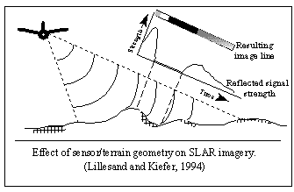
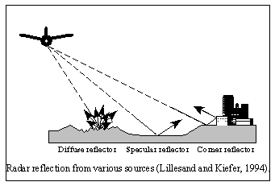
Transmission and Return Characteristics of Radar Signals
-Slopes at near-orthogonal orientations to the incident radar pulse will generally
reflect the energy intensely.
-The strength of the return signal from these gradients is translated into a "bright"
response on the final image.
-Those areas that are blocked from radar "illumination" will yield no return at all.
-These areas will translate into totally black areas on the radar image
-The very high contrast results of many radar images are due to these geometric
phenomena.

Slide 46
Geometric Characteristics
Local incident angle:
High returns from slopes facing the antenna and low or no returns form the slopes that are facing away
As related to surface properties backscatter is dominated by:
0 - 30 degrees ⇒ radar backscatter is dominated by slope
30 - 70 degrees ⇒ radar backscatter is dominated by surface roughness
> 70 degrees ⇒ radar backscatter is dominated by shadows

Slide 47
Geometric Characteristics
Rayleigh criterion: terrain roughness is defined by rms of height of surface variations as compared to wavelength (λ/8) over cosine of local incident angle
Diffuse vs. smooth (specular) reflectors: diffuse produce high signals, specular produce low ones
Modified Rayleigh criterion address intermediate roughness
More specular surfaces in radar imagery than on photographs
Shape and orientation of objects also affects return signal strength, e.g. corner reflectors (strong signal, bright spots)

Slide 48
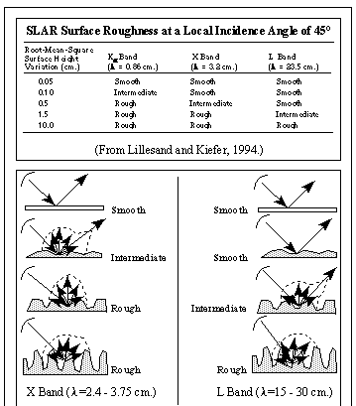
X-band and L-Band radar reflection from surfaces of varying roughness

Slide 49
The Use of SLAR as a Surface Roughness Detector
Surface characteristics of a smaller scale also affect radar return signals
Surfaces are considered "rough" when the root-mean-square (rms) height of the surface variations exceeds one-eighth of the wavelength of sensing (wavelength/8) divided by the cosine of the local incidence angle
The instrument would gather significant radar echoes from the "rough" surface, but would receive no reflected energy from the "smooth" surface.
Specular reflectors are defined as those features with rms height variation of less than wavelength/8 divided by the cosine of the incidence angle.
Particularly strong signals are acquired by "corner reflectors," where the incident energy is reflected twice in such a way that almost all of it is directed back to the sensor.
Anthropogenic structures such as buildings may appear as extremely bright features on radar images

Slide 50
Electrical Characteristics
Complex dielectric constant: indication of reflectivity and conductivity of material
Moisture increases dielectric constant of materials, thus increases radar reflectivity
Type of object (e.g. plant) and atmospheric conditions affect dielectric constant and thus reflectivity

Slide 51
Polarization
In addition to slope orientation, surface roughness, vegetation cover, and water content, polarization also affects signal strength and thus information content of resulting imagery
VV, VH, HH, HV are four polarization

Slide 52
RADAR Summary
Strong signals received by:
Facing slopes
Rough objects
High moisture content
Metal
Corner reflectors (urban areas)
Medium signal is received by most diffuse reflectors
Low signal is received by specular reflectors (water, pavement)
No signal from radar shadow areas

Slide 53
Sentinel-1 Temporal Resolution
The SENTINEL-1 constellation offers an improvement in revisit time over ERS-1/2 and ENVISAT ASAR, and a continuity of wide area coverage with ENVISAT ASAR, but achieving higher resolution and potentially global dual polarisation coverage over landmasses.
Each SENTINEL-1 satellite will be in a near-polar, sun-synchronous orbit, with a 12-day repeat cycle and 175 orbits per cycle. Both SENTINEL-1A and SENTINEL-1B share the same orbit plane with a 180° orbital phasing difference.
A single SENTINEL-1 satellite is potentially able to map the global landmasses in the Interferometric Wide swath mode once every 12 days, in a single pass (ascending or descending). The two-satellite constellation offers a 6 day exact repeat cycle at the equator. Since the orbit track spacing varies with latitude, the revisit rate is significantly greater at higher latitudes than at the equator.

Slide 54
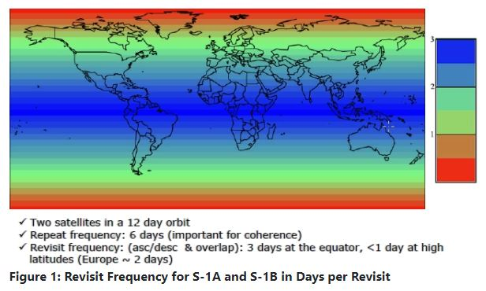
Sentinel-1 Revisit

Slide 55
Sentinel-1 Acquisition Mode
Sentinel-1 operates in four exclusive acquisition modes:
Stripmap (SM)
Interferometric Wide swath (IW)
Extra-Wide swath (EW)
Wave (WV)
The Sentinel-1 C-band SAR instruments supports operation in single polarisation (HH or VV) and dual polarisation (HH+HV or VV+VH),
Implemented through one transmit chain (switchable to H or V) and two parallel receive chains for H and V polarisation.
SM, IW and EW products are available in single (HH or VV) or dual polarisation (HH+HV or VV+VH). WV is single polarisation only (HH or VV).

Slide 56
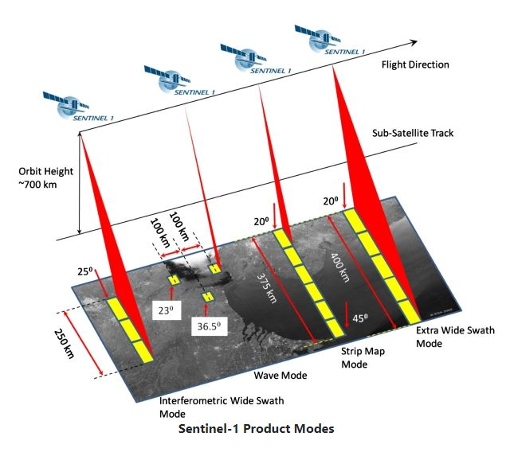
Acquisition Mode

Slide 57
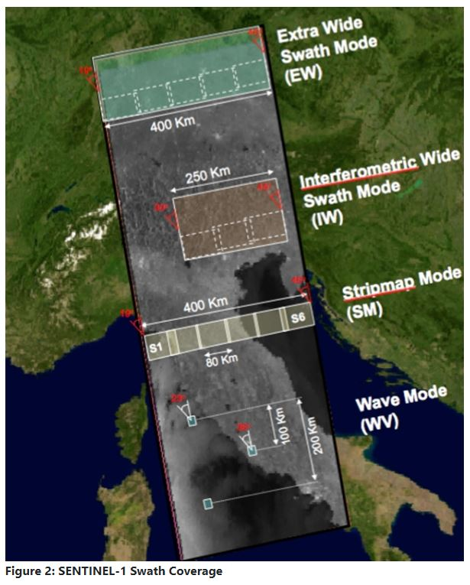
Swath Coverage

Slide 58
Sentinel-1 Spatial Resolution
Spatial resolutions depend on the acquisition mode and the level of processing.
Level-1 SLC
Level-1 GRD
Level-2 OCN.

Slide 59
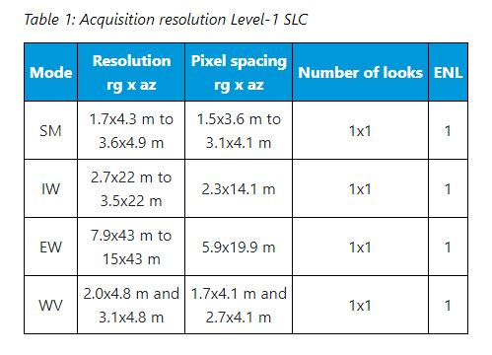
Level-1 Single Look Complex

Slide 60
Sentinel-1 Acquisition Mode
Sentinel-1 operates in four exclusive acquisition modes:
Stripmap (SM)
Interferometric Wide swath (IW)
Extra-Wide swath (EW)
Wave (WV)
The Sentinel-1 C-band SAR instruments supports operation in single polarisation (HH or VV) and dual polarisation (HH+HV or VV+VH),
Implemented through one transmit chain (switchable to H or V) and two parallel receive chains for H and V polarisation.
SM, IW and EW products are available in single (HH or VV) or dual polarisation (HH+HV or VV+VH). WV is single polarisation only (HH or VV).

Slide 61
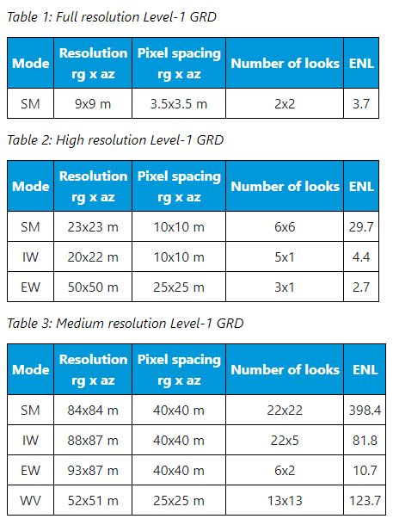
Level-1 Ground Range Detection (GRD)

Slide 62
Level-2 Ocean (OCN)
For Level-2 OCN products, the swell spectra (OSW) are provided at a spatial resolution of 20 km by 20 km
The wind fields (OWI) and surface radial velocity (RVL) components have a spatial resolution of 1 km by 1 km (for SM/IW/EW)
For WV, the results are average on the 20x20km grid, giving only 1 value by vignettes

Slide 63
Use of Sentinel-1 in Agriculture
Monitoring of crop conditions, soil properties and mapping tillage activities, help to assess land use, predict harvests, monitor seasonal changes and assist in implementing policy for sustainable development.
Sentinel-1 can also be used for monitoring the changes of agricultural production and productivity of pastures caused by drought and monitoring the decline of land productivity and soil degradation due to excessive cultivation and pasturage and improper irrigation.
Agricultural maps enable provision of independent and objective estimates of the extent of cultivation in a given country or growing season, which can be used to support efforts to ensure food security in vulnerable areas.

Slide 64
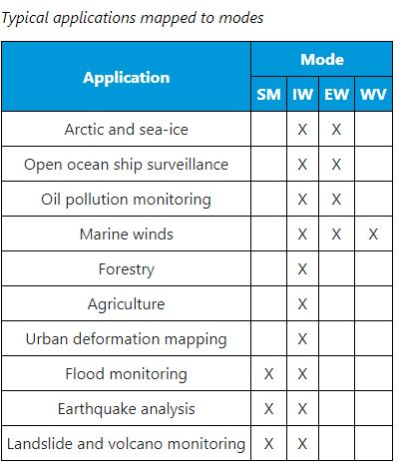
Mapping of Applications to Sentinel-1 Modes

Slide 65
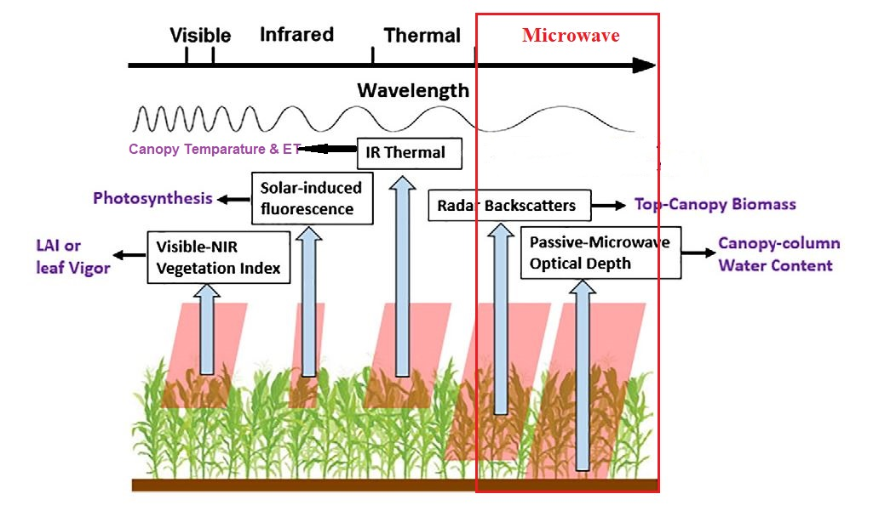
An Example: Microwave Spectrum Used in Corn Yield Estimation

